Slide 1
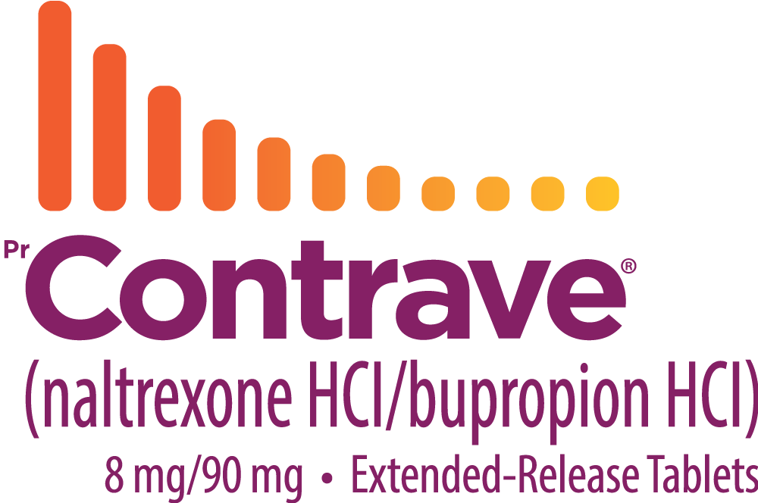
Obesity is a chronic disease²
Are you treating it as one?
“Health care providers should assess their own attitudes and beliefs regarding obesity
and consider how their attitudes and beliefs may influence care delivery.”
~Adapted from the 2020 Obesity Canadian Clinical Practice Guidelines³
Refer to complete guidelines for full recommendations.

Slide 2
An anti-obesity agent for chronic weight management¹
Naltrexone/bupropion combination is a recommended option, in conjunction with medical nutrition therapy, physical activity, and psychological interventions, for individuals with a
BMI ≥30 kg/m² or ≥27 kg/m² with adiposity-related comorbidities.
~Adapted from the 2020 Obesity Canadian Clinical Practice Guidelines⁴
Refer to complete guidelines for full recommendations.

Slide 3

A dual-component mechanism of action¹*
+
Bupropion
A relatively weak inhibitor of the neuronal reuptake of dopamine and norepinephrine
=
Naltrexone
An opioid antagonist
CONTRAVE
Non-clinical studies suggest that CONTRAVE has effects on two separate areas of the brain involved in the regulation of food intake.
The exact neurochemical effects of CONTRAVE leading to weight loss are not fully understood.
Hypothalamus
(appetite regulatory centre)
Mesolimbic
dopamine circuit
(reward system)
Adapted from the Product Monograph.
* Clinical significance is unknown.

Slide 4
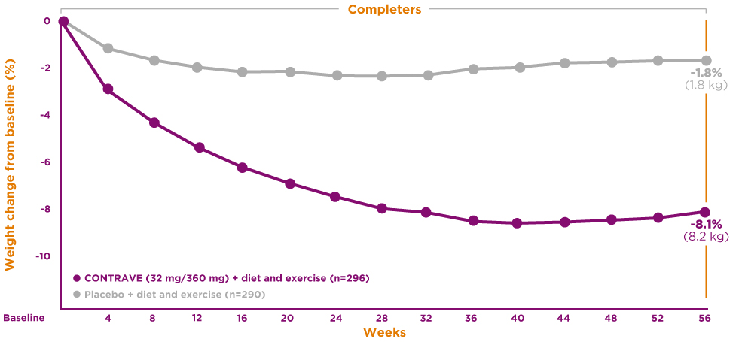
CONTRAVE demonstrated significantly more weight loss vs. placebo
Mean change in body weight was -5.4% in the CONTRAVE 32 mg/360 mg group vs. -1.3% in the placebo group (primary endpoint, ITT population).
COR-I: Mean change in weight over 56 weeks in the completer population¹*
4X more weight loss
with CONTRAVE
in the ITT population
(primary endpoint, LOCF)
-1.3% (1.4 kg)
placebo
-5.4% (5.5 kg)
CONTRAVE
(p<0.001)
50.1% of patients in the placebo
group and 49.2% of patients
in the CONTRAVE group
discontinued treatment.
ITT: intention to treat; LOCF: last observation carried forward.
Adapted from the Product Monograph.
* A phase 3, 56-week multicenter, double-blind, placebo-controlled study of patients with obesity (BMI ≥30 kg/m²) or overweight (BMI ≥27 kg/m²) and at least one comorbidity (hypertension or dyslipidemia). Patients were randomized to naltrexone (16–50 mg/day) and/or bupropion (300–400 mg/day) or placebo. Results presented are for the recommended daily dose of two 8 mg/90 mg tablets taken twice daily for a total dose of 32 mg/360 mg. Treatment was initiated with a 3-week dose-escalation period followed by approximately 1 year of continued therapy. Treatment included a program consisting of instruction to follow a reduced-calorie diet resulting in an approximate 500 kcal/day decrease in caloric intake, behavioural counselling, and increased physical activity. Co-primary endpoints were percent change from baseline body weight and proportion of subjects achieving ≥5% total decreased body weight. Mean baseline weight for CONTRAVE/placebo: 99.8 kg (n=538)/99.5 kg (n=536). Other mean baseline values for CONTRAVE/placebo: waist circumference (cm) 108.8/110.0; triglycerides (mmol/L) 1.3/1.3; HDL-C (mmol/L) 1.3/1.3; LDL-C (mmol/L) 3.1/3.1; systolic blood pressure (mmHg) 118.9/119.0; diastolic blood pressure (mmHg) 77.1/77.3; heart rate (bpm) 72.1/71.8.

Slide 5
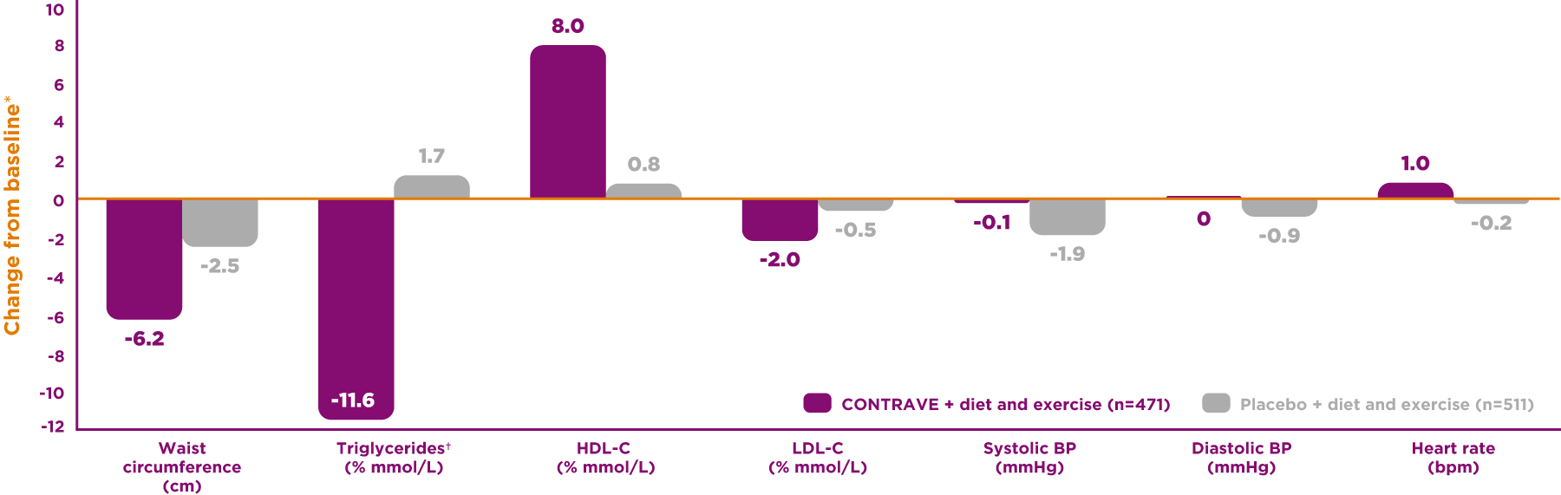
Demonstrated effect of CONTRAVE on cardiovascular and metabolic parameters
The effect of CONTRAVE on cardiovascular morbidity and mortality has not been established.
COR-I: Change from baseline to week 56 in patients overweight or with obesity, and without diabetes¹
BP: blood pressure; HDL-C: high-density lipoprotein cholesterol; LDL-C: low-density lipoprotein cholesterol.
Adapted from the Product Monograph.
* Least square means, from all randomized subjects who had a baseline measurement and had at least one post baseline body weight measurement while on study drug. Based on LOCF with the last on drug
observation carried forward.
† Values are baseline median, median % change, and the Hodges-Lehmann estimate of the median treatment difference.

Slide 6
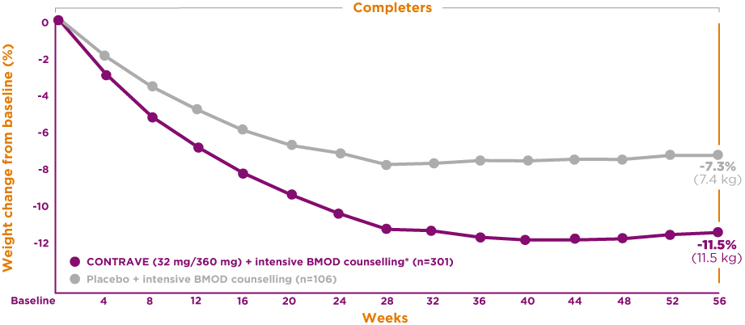
CONTRAVE demonstrated significantly more weight loss vs. placebo
In conjunction with intensive BMOD counselling*
Mean change in body weight was -8.1% in the CONTRAVE 32 mg/360 mg group vs. -4.9% in the placebo group (primary endpoint, ITT population).
COR-BMOD: Mean change in weight over 56 weeks in the completer population^{1†}
Significantly more weight
loss with CONTRAVE
in the ITT population
(primary endpoint, LOCF)
-4.9% (5.0 kg)
placebo
-8.1% (8.1 kg)
CONTRAVE
(p<0.001)
41.6% of patients in the placebo group and 42.1% of patients in the CONTRAVE group discontinued treatment.
BMOD: behavioural modification; ITT: intention to treat; LOCF: last observation carried forward.
Adapted from the Product Monograph.
* Intensive behavioural modification program consisting of 28 group counselling sessions over 56 weeks combined with a prescribed diet and exercise program.
† A phase 3, 56-week multicenter, double-blind, placebo-controlled study of patients with obesity (BMI ≥30 kg/m²) or overweight (BMI ≥27 kg/m²) and at least one comorbidity (hypertension or dyslipidemia). Patients were randomized to naltrexone (16–50 mg/day) and/or bupropion (300–400 mg/day) or placebo. Results presented are for the recommended daily dose of two 8 mg/90 mg tablets taken twice
daily for a total dose of 32 mg/360 mg. Treatment was initiated with a 3-week dose-escalation period followed by approximately 1 year of continued therapy. Treatment included an intensive behavioural modification program consisting of 28 group counselling sessions over 56 weeks as well as a prescribed diet and exercise program. Co-primary endpoints were percent change from baseline body
weight and proportion of patients achieving ≥5% total decreased body weight. Mean baseline weight for CONTRAVE/placebo: 100.3 kg (N=565)/101.8 kg (N=196). Other mean baseline values for CONTRAVE/placebo: waist circumference (cm) 109.3/109.0; triglycerides (mmol/L) 1.24/1.16; HDL-C (mmol/L) 1.6/1.4; LDL-C (mmol/L) 2.8/2.8; systolic blood pressure (mmHg) 116.9/116.7;
diastolic blood pressure (mmHg) 78.2/77.2; heart rate (bpm) 70.7/70.4.

Slide 7
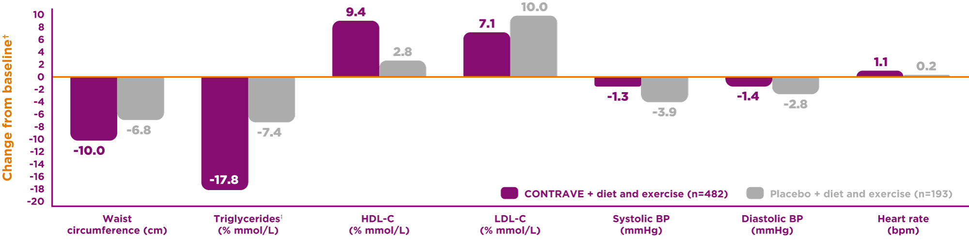
Demonstrated effect of CONTRAVE on cardiovascular and metabolic parameters in COR-BMOD
In conjunction with intensive BMOD counselling*
The effect of CONTRAVE on cardiovascular morbidity and mortality has not been established.
COR-BMOD: Change from baseline to week 56 in patients overweight or with obesity, and without diabetes¹
BMOD: behavioural modification; BP: blood pressure; HDL-C: high-density lipoprotein cholesterol; LDL-C: low-density lipoprotein cholesterol.
* Intensive behavioural modification program consisting of 28 group counselling sessions over 56 weeks combined with a prescribed diet and exercise program.
† Least square means, from all randomized patients who had a baseline measurement and had at least one post-baseline body weight measurement while on study drug. Based on LOCF with the last on-drug observation carried forward.
‡ Values are baseline median, median % change, and the Hodges-Lehmann estimate of the median treatment difference.

Slide 8
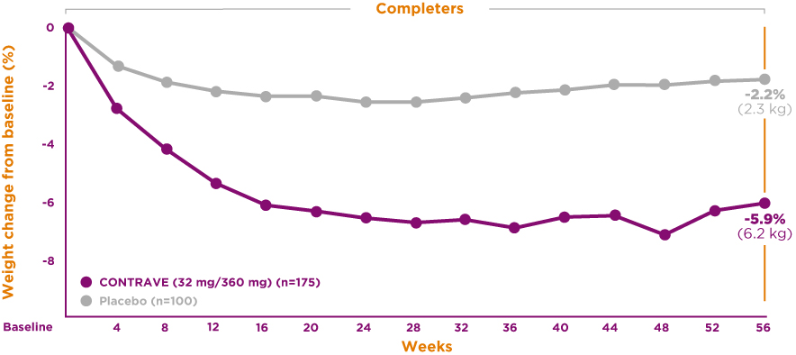
CONTRAVE demonstrated significantly more weight loss vs. placebo
Patients with overweight or obesity and type 2 diabetes
Mean change in body weight was -3.7% in the CONTRAVE 32 mg/360 mg group vs. -1.7% in the placebo group (primary endpoint, ITT population).
COR-Diabetes: Mean change in weight over 56 weeks in the completer population¹*
2.2X more weight loss
with CONTRAVE
in the ITT population
(primary endpoint, LOCF)
-1.7% (1.8 kg)
placebo
-23.7% (3.9 kg)
CONTRAVE
(p<0.001)
41.2% of patients in the placebo group and 47.8% of patients in the CONTRAVE group discontinued treatment.
ITT: intention to treat; LOCF: last observation carried forward.
Adapted from the Product Monograph.
* A phase 3, 56-week multicenter, double-blind, placebo-controlled study of patients with obesity (BMI ≥30 kg/m²) or overweight (BMI ≥27 kg/m²) with type 2 diabetes mellitus with or without hypertension and/or dyslipidemia and not achieving glycemic goal of a HbA1c less than 7% either with or without oral antidiabetic agents. Patients were randomized to naltrexone (16–50 mg/day) and/or bupropion
(300–400 mg/day) or placebo. Results presented are for the recommended daily dose of two 8 mg/90 mg tablets taken twice daily for a total dose of 32 mg/360 mg. Treatment was initiated with a 3-week dose-escalation period followed by approximately 1 year of continued therapy. Treatment included a program consisting of instruction to follow a reduced-calorie diet resulting in an approximate 500 kcal/day decrease in caloric intake, behavioural counseling, and increased physical activity. Co-primary endpoints were percent change from baseline body weight and proportion of patients achieving ≥5% total decreased body weight. Mean baseline weight for CONTRAVE/placebo: 104.2 kg (N=321)/105.3 kg (N=166). Other mean baseline values for CONTRAVE/placebo: HbA1c (%) 8.0/8.0; fasting glucose (mmol/L) 8.9/9.1; waist circumference (cm) 115.6/114.3; triglycerides (mmol/L) 1.7/1.9; HDL-C (mmol/L) 1.2/1.2; LDL-C (mmol/L) 2.6/2.6; systolic blood pressure (mmHg) 125.0/124.5; diastolic blood pressure (mmHg) 77.5/77.4; heart rate (bpm) 72.9/73.1.

Slide 9
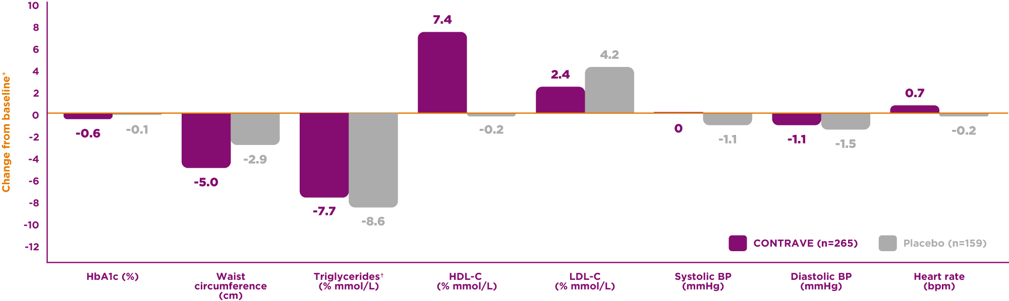
Demonstrated effect of CONTRAVE on cardiovascular and metabolic parameters in COR-Diabetes
The effect of CONTRAVE on cardiovascular morbidity and mortality has not been established.
COR-Diabetes: Change from baseline to week 56 in patients overweight or with obesity, and with type 2 diabetes¹
BP: blood pressure; HbA1c: glycated hemoglobin; HDL-C: high-density lipoprotein cholesterol; LDL-C: low-density lipoprotein cholesterol.
* Least square means, from all randomized patients who had a baseline measurement and had at least one post-baseline body weight measurement while on study drug. Based on LOCF with the last on-drug observation carried forward.
† Values are baseline median, median % change, and the Hodges-Lehmann estimate of the median treatment difference.

Slide 10
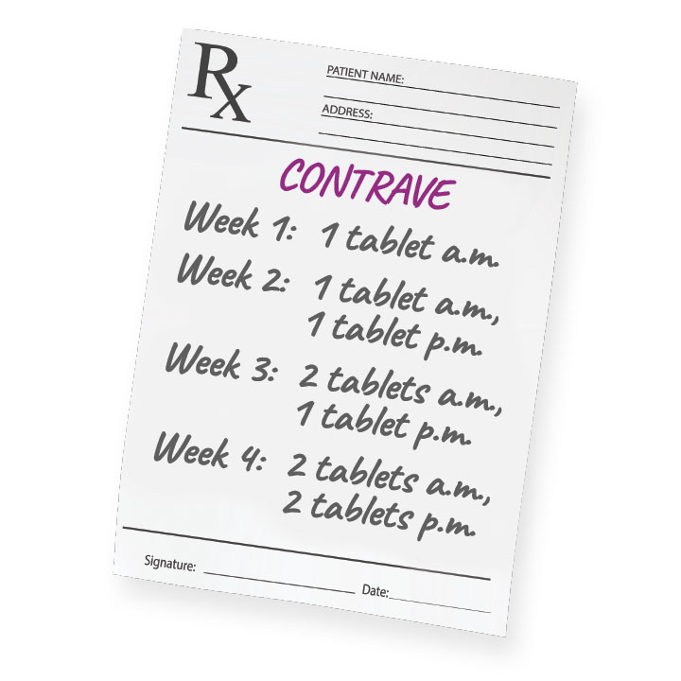
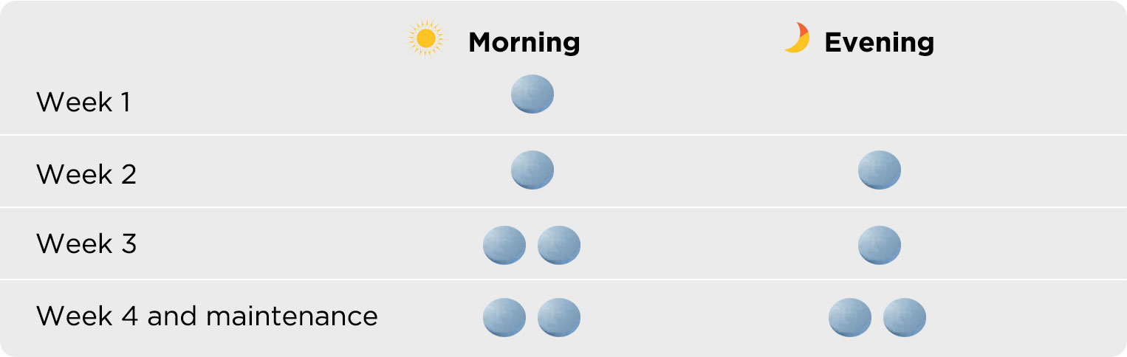
Recommended daily dose: two tablets twice daily¹
CONTRAVE dosing should be escalated accordingly:
In order to minimize the risk of seizures, the maximum recommended daily dose should not be exceeded.
Response to therapy should be evaluated after 12 weeks at the maintenance dosage. If a patient has not lost at least 5% of baseline body weight, discontinue CONTRAVE, as it is unlikely that the patient will achieve and sustain clinically meaningful weight loss with continued treatment.
Dosage adjustments are required in patients with hepatic impairment (maximum dose 1 tablet in the morning in mild or moderate hepatic impairment) or renal
impairment (maximum dose 2 tablets, one in the morning and one in the evening in moderate or severe renal impairment), and with concomitant use of CYP2B6 inhibitors
(maximum dose 2 tablets, one in the morning and one in the evening). All patients with hepatic or renal impairment should be closely monitored for possible adverse effects (e.g., insomnia, dry mouth, seizures) that could indicate high drug or metabolite levels.
CONTRAVE should not be taken with a high-fat meal. The tablets should not be cut, chewed, or crushed.
Blood pressure and pulse should be measured prior to starting therapy with CONTRAVE and should be monitored at regular intervals consistent with usual clinical practice. CONTRAVE should not be given to patients with uncontrolled hypertension and should be used with caution in patients with controlled hypertension prior to treatment.
Please consult the Product Monograph for complete dosage and administration information.

Slide 11




Personalized support to complement your patients’ treatment journey
Financial assistance to cover up to 20% off total prescription costs
Because each person’s weight management experience is unique
Nurse counsellors take the time to understand your patient’s personal experience through regular phone calls
Weekly emails with newsletters and videos provide ongoing education and support between check-ins
Ongoing, one-on-one motivational coaching from an assigned nurse counsellor
Educational and motivational content developed by hand-picked specialists in the field of obesity and weight management
“It felt almost like talking to a friend. She was very personable.”
- Actual patient. May not be representative of all patient experiences.

Slide 12
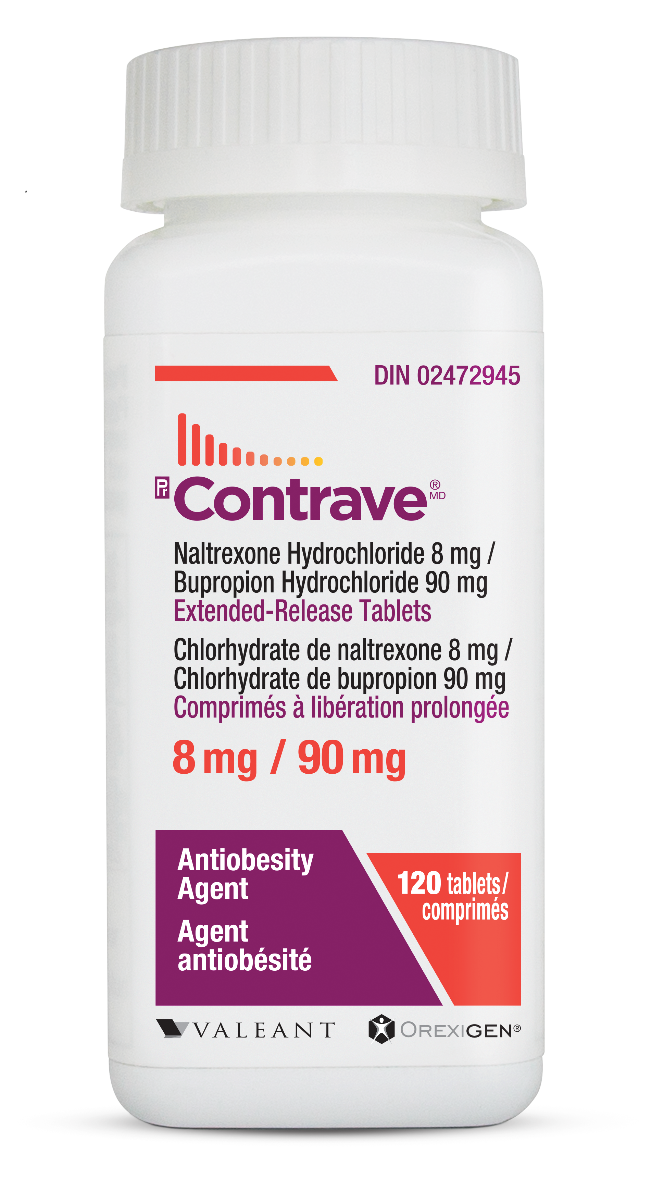

ExperienceContrave.ca
Getting patients started on their treatment journey – adapted for virtual practice
Patients can visit the enrollment website ExperienceContrave.ca and get their CONTRAVE Support Program Card
Patients use their CONTRAVE Support Program Card to pick up their first month of CONTRAVE for free at their usual pharmacy
Patients can register for continued motivational and financial support through the CONTRAVE Support Program

Slide 13

Clinical use:
The effect on cardiovascular morbidity and mortality has not been established
The safety and effectiveness in combination with other products intended for weight loss, including prescription drugs, over-the-counter drugs, and herbal preparations, have not been established.
Geriatrics (≥65 years of age): Use with caution
Pediatrics (<18 years of age): Not indicated
Contraindications:
Uncontrolled hypertension
Seizure disorder or a history of seizures
Use of other bupropion hydrochloride-containing products
Current or prior diagnosis of bulimia or anorexia nervosa
Chronic opioid or opiate agonist or partial agonists use, or acute opiate withdrawal
Patients undergoing an abrupt discontinuation of alcohol, benzodiazepines or other sedatives and antiepileptic drugs
Concomitant administration of monoamine oxidase inhibitors (MAOI)
Concomitant administration of the antipsychotic thioridazine
Pregnancy
Severe hepatic impairment
End-stage renal failure
Most serious warnings and precautions:
Potential association with behavioural and emotional changes, including self-harm: monitor for suicidal ideation and for agitation-type emotional and behavioural changes
Seizures: to minimize the risk of seizures, the maximum recommended daily dose should not be exceeded
Other relevant warnings and precautions:
Interference with the action of opioid-containing drug products, vulnerability to opioid overdose, and precipitated opioid withdrawal
Increase in blood pressure and heart rate; not for use in patients with uncontrolled hypertension and caution in patients with controlled hypertension
Dependence/tolerance
Risk of hypoglycemia in patients with type 2 diabetes on antidiabetic therapy
Hepatotoxicity; discontinue in the event of symptoms and/or signs of acute hepatitis
Drugs metabolized by CYP2D6; do not use in combination with tamoxifen
Angle-closure glaucoma
Activation of mania and hallucinations
Allergic reactions
Not recommended in nursing mothers
Closely monitor patients with hepatic and renal impairment; dose adjustments required in mild to moderate hepatic impairment and moderate or severe renal impairment
Contains lactose
For more information:
Please consult the Product Monograph for important information relating to adverse reactions, drug interactions, and dosing information which have not been discussed in this piece. The Product Monograph is also available by calling 1-800-361-4261.
References:
CONTRAVE Product Monograph. Bausch Health, Canada Inc.
Wharton S, Lau DCW, Vallis M et al. Obesity in adults: a clinical practice guidelines. CMAJ 2020;192:E875-91.
Kirk S, Ramos Salas X, Alberga AS, Russl-Mayhew S. Reducing Weight Bias, Stigma and Discrimination in Obesity Management, Practice Policy. Available from: https://obesitycanada.ca/guidelines/weightbias. Accessed December 8, 2020.
Pedersen SD, Manjoo P, Wharton S. Canadian Adult Obesity Clinical Practice Guidelines: Pharmacotherapy in Obesity Management. Available from: https://obesitycanada.ca/guidelines/pharmacotherapy. Accessed October 26, 2020.
CONTRAVE and the CONTRAVE logo are registered trademarks of Nalpropion Pharmaceuticals, Inc., used under license.
© 2021 Bausch Health, Canada Inc. Laval, Québec H7L 4A8. All rights reserved.
The information is intended only for residents of Canada.

